Slide 1
Asset Model Sustainment:
Normalizing PSM Elements to Most Current Physical Assets
Deidra Armstrong, Business Enablement, Manager - Sinclair Oil Corporation David Horn, Consultant, GembaSys
Bruce Taylor, Business Enablement, Director - Sinclair Oil Corporation

Slide 2
The Story Line….
Business Themes
Technical Themes
The Enterprise
Situational Needs
The Opportunity
The Approach
Results
Physical architecture
Data process flow
Business rules / logic
Advantage of approach

Slide 3
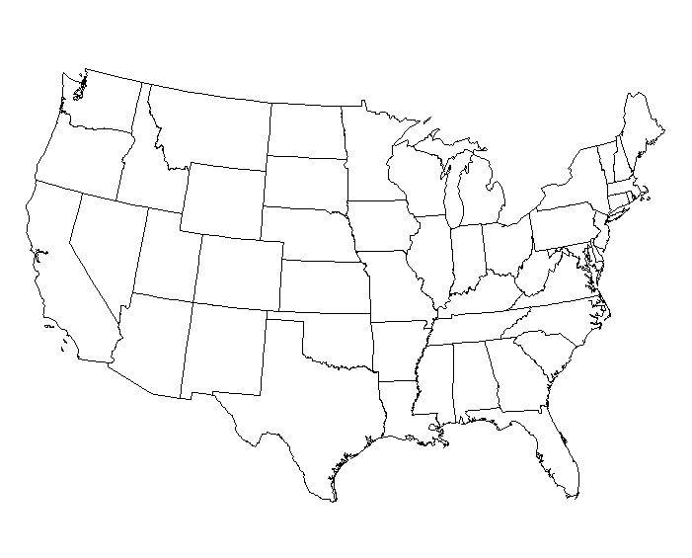
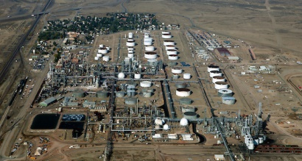
The Sinclair Oil Enterprise
Sinclair Oil Corporation
Privately held integrated oil enterprise
Headquartered in Salt Lake City, Utah
Sinclair Wyoming Refining Company
Location: Sinclair, Wyoming
Size: ~75k/bpd
Complex facility; hydrocracking, hydrotreating, delayed coking
5 major products; propane, gasoline, jet, diesel, asphalt

Slide 4
The Situation
Vision: Achieve and sustain industry leading performance
Safety
Reliability
Profitability
Progress: Significant advancements in past 5 years
Mechanical
Cultural
Work processes and performance measurements
Next Step: Leverage Investments / Address Key Opportunity
Information Technologies
Business and Operational Discipline

Slide 5
The Key Opportunity
Enviable set of marque software
Process Automation
Process Data Archive
CMMS (Maximo)
MI
LIMS
EHS
AIM
CAD/CAE
Information is scattered in numerous ‘silos’ developed around specific applications within functional areas of the organization and functionally reported
Classic Challenge

Slide 6
Approaching Digital Transformation
Strategy
Standards
Creation and Sustainment of Asset Model (ISO 15926)
Adoption of MES/MOM methods and standards (ANSI/ISA 95)
Provide Operational Intelligence (OI) / Situational Awareness (SA)
Embracing IIoT - Implementation of site-wide Wireless Umbrella
Key Driver (Why is this work important)
Sustaining pace of business and operations improvements requires single valid unifying master reference model; and
Sustaining accuracy and thoroughness is key to the model’s validity

Slide 7
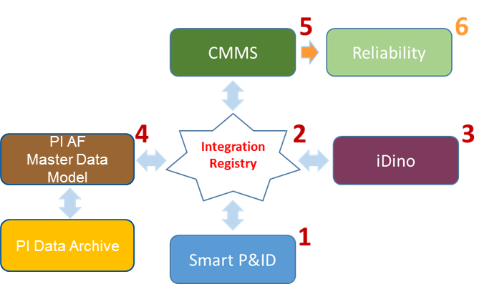
SWRC Case Study
Asset Model Sustainment / Process Information Flow
Ensure / Validate sustainment capabilities
Use asset information already gathered
Enhanced business capabilities driven by existing MOC and engineering processes
Changes made to drawings
IR registry updated
Review and approve changes
Changes update in asset model
Changes updated in CMMS (Maximo)
Changes updated in Reliability
(IR)

Slide 8
Data flow diagram (Class/Templates)
Synchronize CAD asset template library to mirror PI AF as appropriate
Share attribute dictionaries and other metadata standards
Smart P&ID System
Asset Framework Servers
CMMS (Maximo)
OI Clients
Integration Server
Future

Slide 9
Data flow diagram (Elements & Attributes From PI AF)
Synchronize Maximo to identify what is to be provided from the model
Share dictionaries and metadata information
Smart P&ID System
Asset Framework Servers
CMMS (Maximo)
OI / OSIsoft Clients
Integration Server
Future

Slide 10
Data flow diagram (Elements From CAD)
Delta changes identified from P&ID
Change is processed in ‘registry’ to record change and manage / direct transaction
Asset record is ‘pre-processed’ for target and published
Smart P&ID System
Asset Framework Servers
CMMS (Maximo)
OI / OSI Clients
Integration Server
Future

Slide 11
SWRC Case Study
SQL integration services utilized to capture changes and synchronize

Slide 12
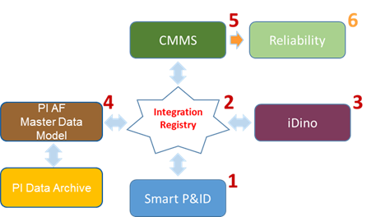
SWRC Case Study
Changes captured for approval before being propagated

Slide 13
SWRC Case Study
Asset / Component created in Asset Model with associated attributes and metadata

Slide 14
SWRC Case Study
Asset / Component propagated from Asset Model to Maximo with associated attributes and metadata

Slide 15
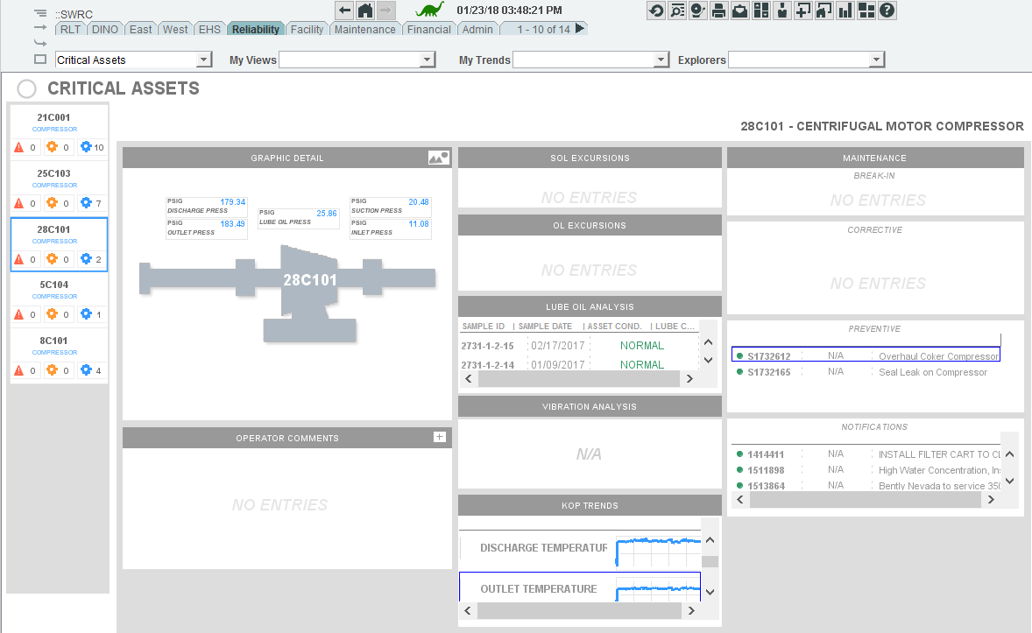
SWRC Case Study
The Value
Easily Aggregate
Current Operating Data
SOL/IOW Alerts
Lube Data
Key Operating Parameters
Maintenance Status & History
and More…
Dynamically Generated by Just Setting Critical Status

Slide 16
Phase 2 Roadmap
Expand the Asset Framework
Dynamically drive model into any/all associated applications
Extend model synchronization beyond Maximo
Reliability (MI)
Process Safety Management (PSM)
Environmental, Health and Safety (EHS)
Asset Information/Document Management (AIM)
Financial Performance (ERP)
Leverage Additional Value
Enhanced Analytics
Risk Management
Cost Management
Operation performance; i.e. Key Performance/Operational Indicators for Energy, Availability, Asset Utilization, etc.
Industrial Internet of Things (IIoT)

Slide 17
Leveraging Value from Normalizing Master Asset Model
Sinclair Oil relentlessly pursues a safe, reliable, environmentally responsible and a profitable operation, ensuring a sustainable future for our owners and employees and the communities where we operate
Information scattered in silos, developed around specific applications and business functions
Digital Transformation program around single standards driven master data model / broker
Simplified business process and more informed decision support
No unifying asset hierarchy
Burden of manual model sync’
Potential for inconsistency
Information delay
Loss of business value
Apply Industry standards
Embrace IIoT
Balance data and people Judgment
Tag and meta data abstraction
Sustainable and scalable model for operational technology (OT) and information technology (IT) data resulting in sustainable transformative business value

