Slide 1
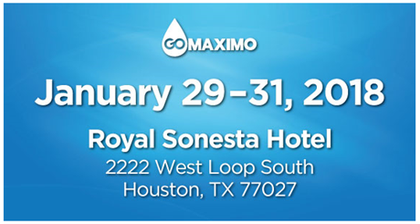
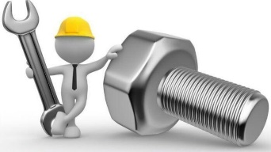
Asset Management System
as defined by the
Uptime Elements Framework
Session #1
Session #2
Jan. 29th Monday
8:30am – 9:15am
Champions III
Jan. 29th Monday
9:30am – 10:15am
Champions VII
from a Maximo Perspective
John Reeve, Author, CRL, CMMS Champion

Slide 2
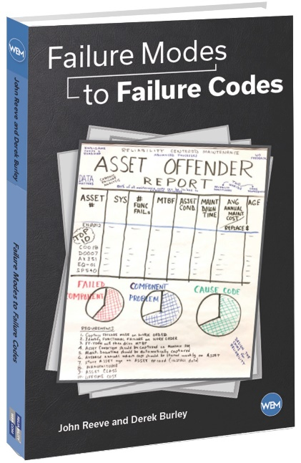
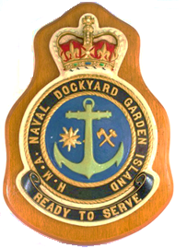
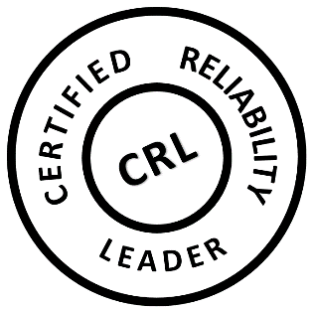
Speaker Background
Grand Gulf
Nuclear Station
U.S Patent 7,421,372 Maintenance
Scheduling
2nd consultant hired by the company that invented Maximo.
Spent the first 10 years as an international consultant in project management supporting cost/schedule design. Aerospace and defense industries, as well as nuclear power, depended on this software.
U.S. Patent in maintenance scheduling – called the “order of fire” for resource leveling
In the following 20 years, specialized in asset management design.
Certified Reliability Leader
13,000 LinkedIn followers
100 postings on industry best practices, numerous trade magazine articles
Frequent speaker at Reliability Web and Maximo software venues
Book: Failure Modes to Failure Codes
Able to comfortably discuss advanced processes for both asset reliability and work force productivity.
Significant overseas assignments include Australian Defence Industry (Sydney), Australian Submarine Corporation (Adelaide), Pohang Steel (South Korea), Guangdong Nuclear Power (China) and Power Generation Company of Trinidad.
Aided in 1st RCM for Maximo Industry Best Practices course, taught as PSDI consultant
100
Posts

Slide 3
Asset Reliability
Journey
RELIABILITY LEADERs
CMMS PRACTITIONERS
MX S/W CONSULTANTs
COST/SCHED. ANALYSTs

Slide 4
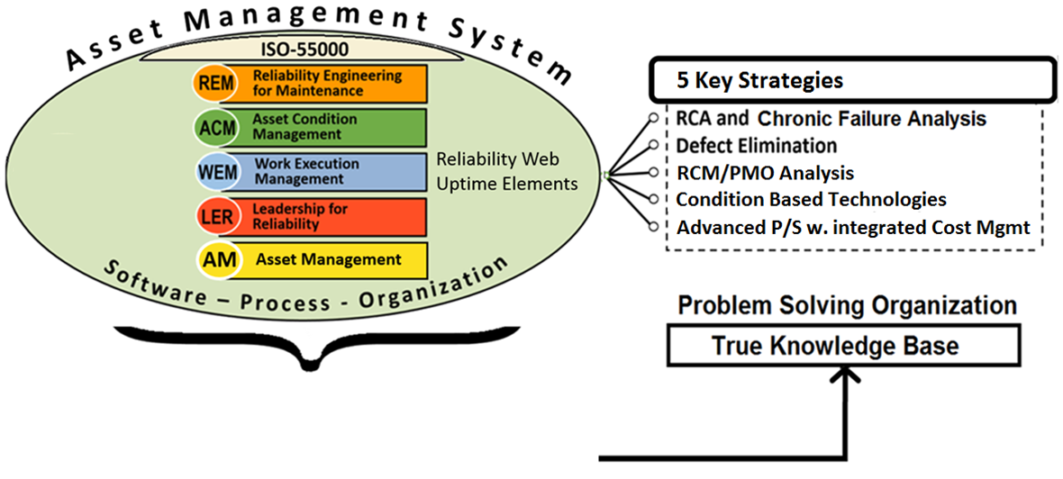
Asset Management is what you extract
from the Asset Management System
Advanced processes provide the largest potential
return on investment
MAXIMO
CMMS
The software may be world class but you still need someone to state the vision, and then, develop supporting processes.

Slide 5
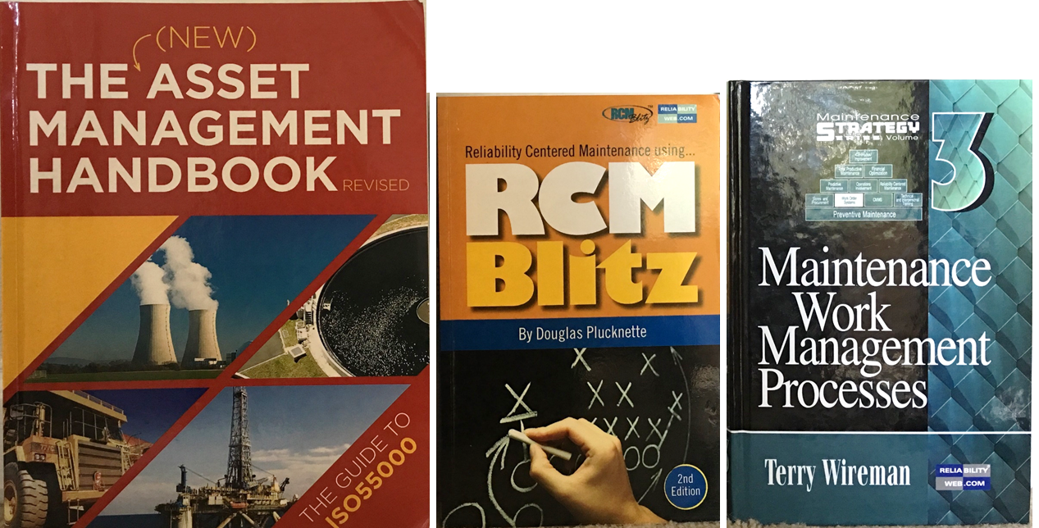
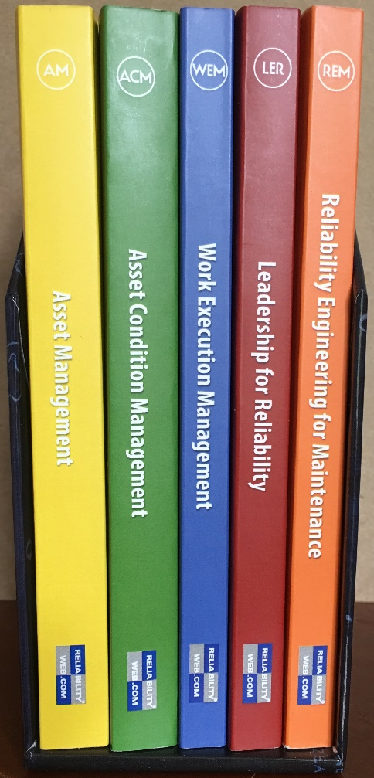
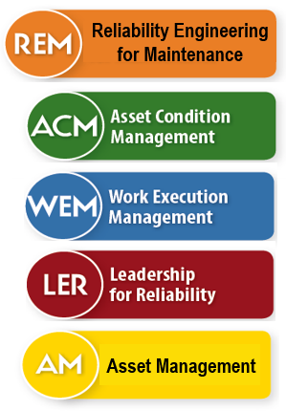
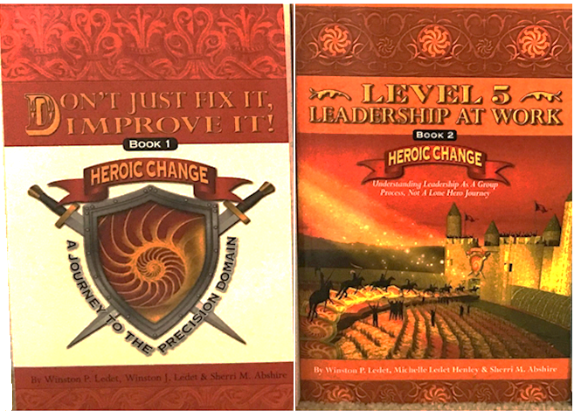
How to get Certified
Read these books
or, attend a 1 week course
Five main verticals
Passport set

Slide 6
Most organizations would benefit from a Long Range Plan
What makes up an
Asset Management System?
What value do the Uptime Elements provide?
How do these elements relate to Maximo?
Notes:
I believe in asset management. I suspect everyone here does also. But, what really is asset management? How do you extract "asset management" from your CMMS? If you could only choose one improvement initiative for the next year, what would that be? And what if it were possible to rank these improvement initiatives in terms of ROI, which one offers the largest potential return on investment? Last question: When someone says your data sucks, what are they usually referring to?

Slide 7
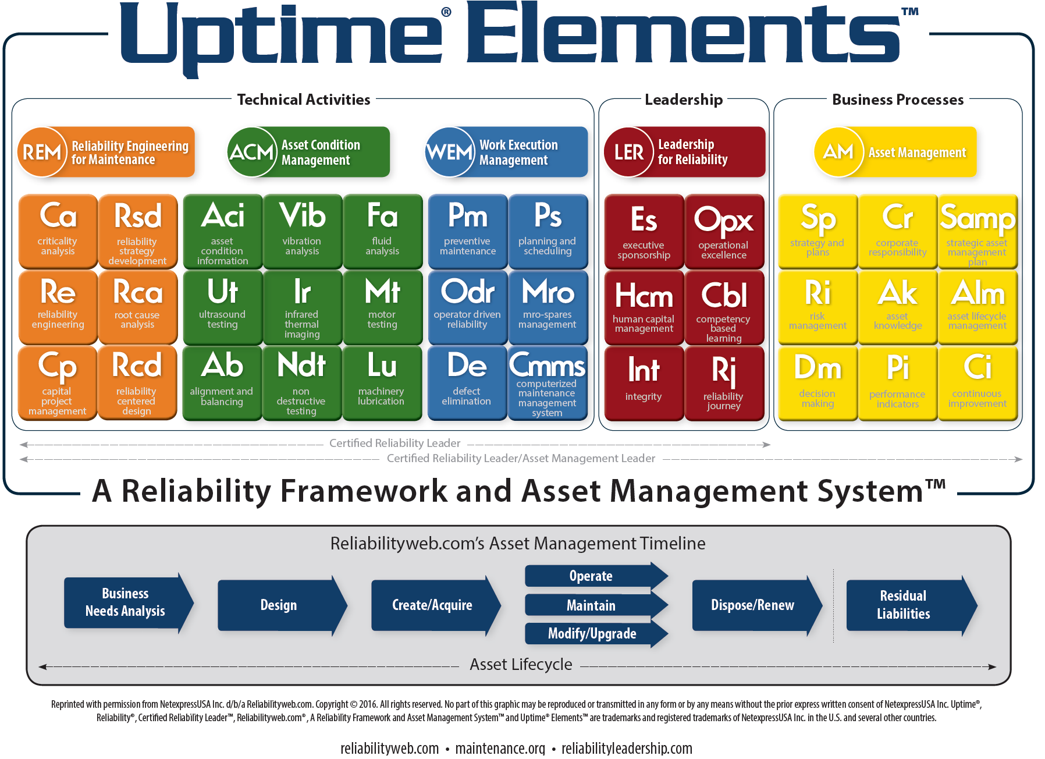
Reliability Engineering
for Maintenance
Asset Management
Criticality
analysis
Reliability
Strategy
development
Asset
Condition
information
Vibration
analysis
fluid
analysis
executive
sponsorship
operational
excellence
strategy and
plans
corporate
responsibility
strategic asset
management plan
Reliability
engineering
Root cause
analysis
Ultrasound
testing
Infrared
Thermal
imaging
motor
testing
human capital
management
competency
based learning
risk
management
asset
knowledge
asset lifecycle
management
Capital
Project
management
Reliability
Centered
design
Alignment &
balancing
Non
Destructive
testing
Machinery
lubrication
integrity
reliability
journey
decision
making
performance
indicators
continuous
improvement

Slide 8
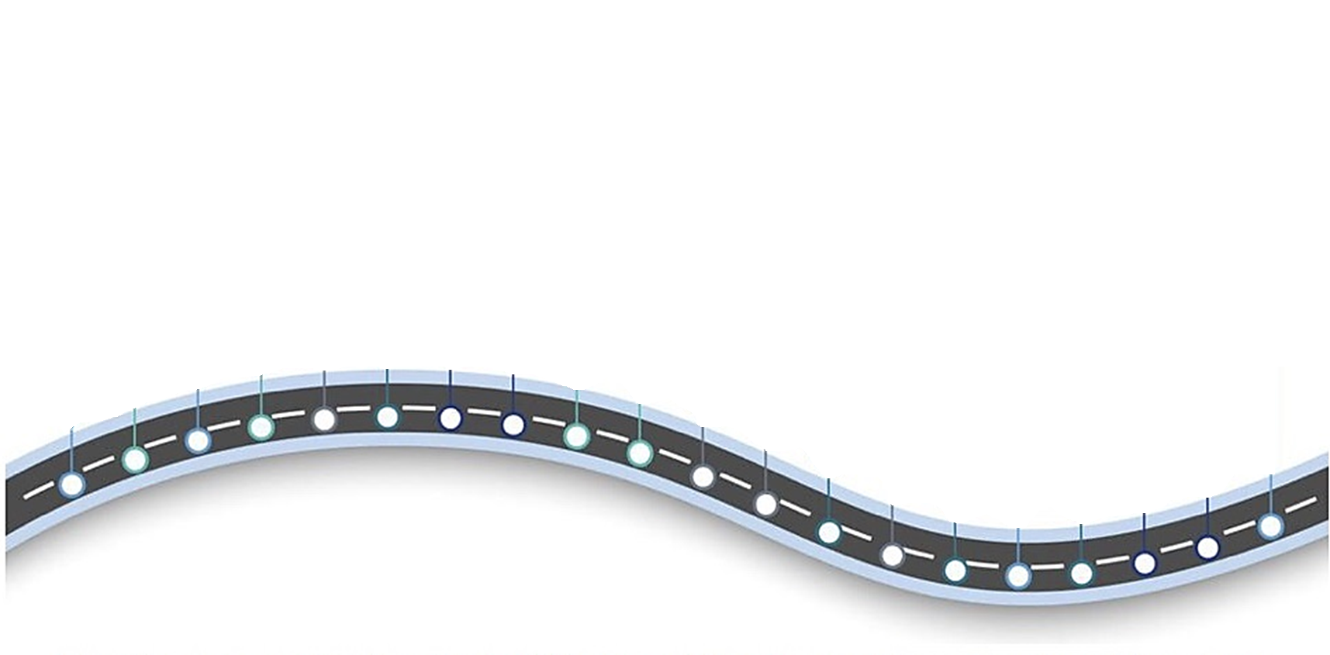
Asset Management Roadmap
Although each journey is unique, the Asset Management Roadmap creates a comprehensive long range plan based on organizational priorities and availabilities.
The Long Range Plan also supports sustainment activities, such as:
Benchmarking activities
Attending Maximo World
Obtaining CRL staff accreditation
Error Checks and Proactive Audits
Assumption:
CMMS is installed.
Organization requests assistance in Asset Management processes
Requests Long Range Plan showing improvement initiatives
Capture Failure Mode on WO
Establish
Core
Team
Define
Critical
Procedures
Perform
GAP
Analysis
Create
Strategic
Plan
Configure
System
04
Identify
Best
Practices
06
Create
AS-IS
TO-BE
08
Define
Failure
Analytic
Create
Action
Plan
02
Identify
Stakeholders
10
Create
Long Range
Plan
07
Create
Reliability
Team
Implement
Chronic
Failure
Analysis
05
Perform
Criticality
Analysis
Optimize
Planning
Scheduling
Define
End-Game
03
09
12
Load
Missing
Foundation
Data
20
01
11
14
Impl.
Mobile
Solution
Conduct
Blended
Training
16
18
Perform
RCM/PMO
Analysis
13
19
15
17
You can install software,
but you cannot install reliability.
Notes:
Document Requirements
Create Process Flows
Gap Analysis
Create Action Plan
Core Team (Charter) & End Game
Business Rules & Definitions
Establish Error Checks
Document Critical Procedures
Create “Power User” training program
Identify Maintenance Analyst
Create Reliability Team
Define Failure Analytic
Implement Mobile Solution
Perform Benchmarking
Conduct Blended Training
Attend Maximo World
Obtain CRL Certifications
Hire Planner/Scheduler
Perform Criticality Analysis
Perform RCM/PMO Analysis

Slide 9
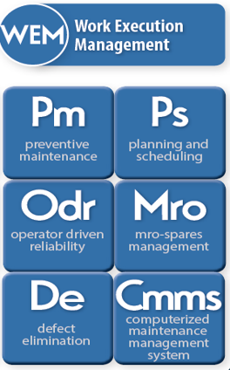
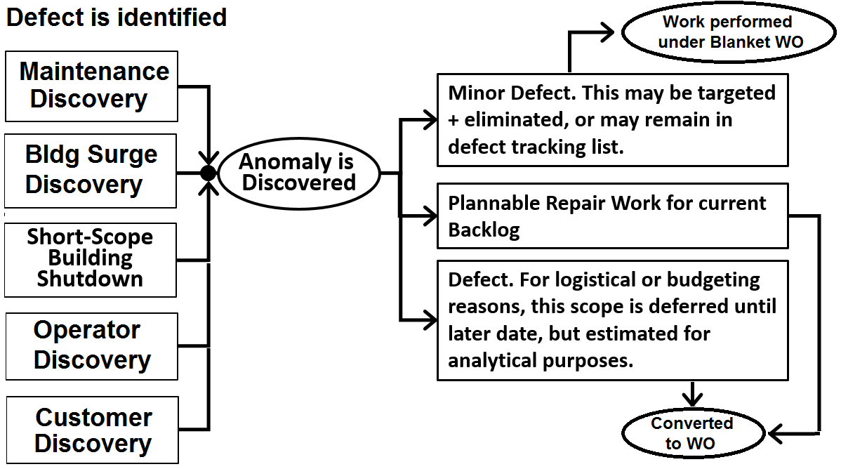
Work Execution Management
is one of five verticals within the Asset Management System framework, provided by
Uptime Elements.
PM, PS and MRO are singled out due to their significance and complexity within Work Execution.
Defects will never stop. They are forever being introduced and perpetuated.
Defects will never stop. They are forever being introduced and perpetuated.
ODR and DE are typically new topics within the CMMS community.
Defect Tracking
Lets start
here.
Reliability LeaderTM, Uptime® ElementsTM, Reliability Framework and Asset Management SystemTM and Reliability LeadershipTM are the trademark(s) or registered trademark(s) of NetexpressUSA Inc. d/b/a Reliabilityweb.com and its affiliates in the USA and in several other countries.
Notes:
Defects will never stop. They are forever being introduced and perpetuated by
· poor procedures and practices,
· poor quality control and
· poor management systems.
Unless you purposefully act to stop defect introduction, every new piece of equipment, every new part, every new person that joins your company bring with them defects and errors, to one day cause future failures. How catastrophic those failures will be will depend on the internal controls you have in place in your organization to prevent and control them. You have to intentionally, proactively, with the future well-being of your business in mind ... put into place a strategy to eliminate and eradicate defects.

Slide 10
Reliability is Everyone’s Job -- including Operations
Goal #1: Build a proactive maintenance program which involves failure mode identification by O&M staff; precision maintenance training for technicians; and RCM training for senior staff. Lastly, get Reliability Engineer involved. Goal #2: Operations personnel should be used in 10-40% of all PM duties. This would free-up maintenance to increase PdM activities, and gain a partner in asset reliability. Operator Driven Reliability has operators performing minor & recurring maintenance tasks. Operators need to accept ownership of asset reliability. They can (1) identify and report failure modes sooner, and, (2) perform basic servicing by replacing filters, and performing lubrication. They could also have basic PdM tools with them on rounds. ODR Basic Tasks – qualifying criteria No more than one basic skill is involved, such as mechanical or electrical; but no special tool requirements Only minor adjustments or lubrication activities Troubleshooting “if then … then this”, e.g. electrical resets or clearing a jam Defect elimination or improvement activities are encouraged No significant disassembly Before starting ODR program, there should be some type of “buy-off” to verify proper operator knowledge. Senior maintenance staff should conduct walkdown to discuss possible failure modes. Every operator who is assigned an ODR task should have access to the single point lesson (SPL). Best-in-Class Tips: Some organizations have Defect Elimination teams who work together to make improvements. In some organizations, the maintenance staff is offered advance training in Condition Based Technologies.
Notes:
ODR is a variant of TPM. Total Productive Maintenance is a strategy that emphasizes cooperation between operations & maintenance. The TPM goal is zero defects, zero accidents, zero breakdowns and an effective workplace design.

Slide 11
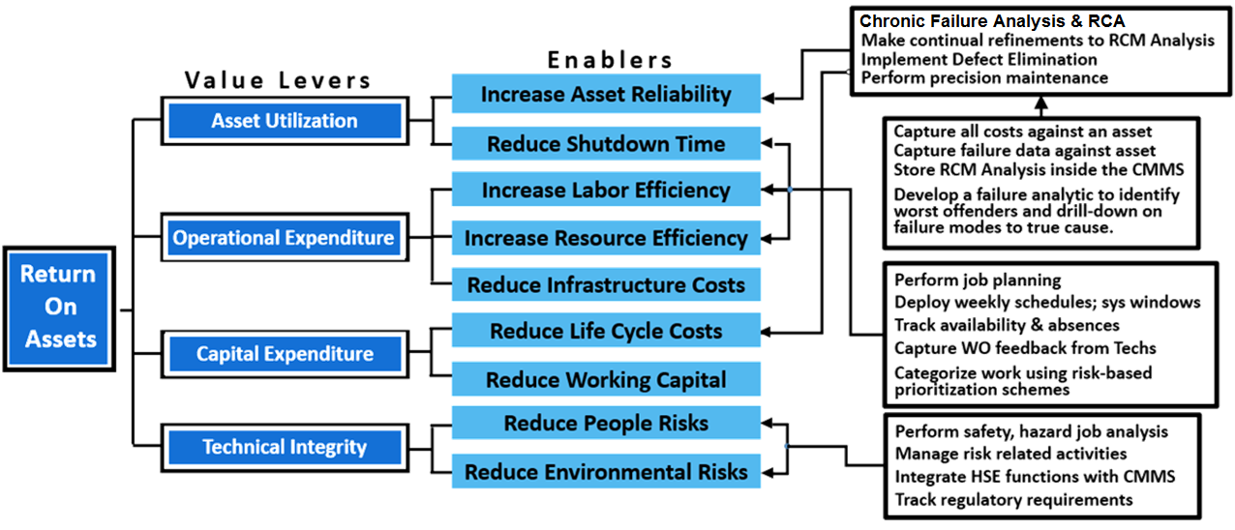
Some Organizations focus heavily on Cost Management
How do you optimize costs to improve reliability?
Reliable companies will have a competitive advantage due to best-in-class practices. This allows them to maintain a positive margin even in a depressed market place.
Maximo Advanced Processes
Notes:
Reliable companies have a competitive advantage due to best-in-class practices. This allows them to maintain a positive margin even in depressed market place. Lastly, a single, cohesive strategy that involves people, culture and excellence provides the best path for success.

Slide 12
Maximo WBS
1.0
CMMS
IMPLEMENT --- UTILIZE --- OPTIMIZE
OPERATOR DRIVEN RELIABILITY
Select CMMS based on
Ability to configure
User community size
Industry-product ratings
Number of available add-ons
Design CMMS to manage by exception
Identify failure analytic and
other key reports
Reverse engineer
input reqmts.
DEFECT ELIMINATION
PLAN & SCHEDULE
RCM ANALYSIS
DAILY
PLAN
PM OPTIMIZATION
BACKLOG
MANAGEMENT
RCM SCREEN INSIDE CMMS
WEEKLY
SCHEDULE
EMER/URGENT – PLANNED CORRECTIVE – PM/PdM - MINOR
CRITICALITY ANALYSIS
RACI
SAFETY-HAZARD REVIEW
cron
ROOT CAUSE ANALYSIS
1.3
ORGANIZATION
WORK PRIORITIZATION + CATEGORIZATION
CHRONIC FAILURE ANALYSIS
RELIABILITY TEAM
STRATEGIC
TACTICAL
1.2
BUSINESS PROCESS
Vision-mission
Dept Goals
Business Rules
Flow charts
CMMS SOPs
KPIs + metrics
ANALYTICAL REPORT DESIGN
WO Initiation
ASSET CONDITION
1.1
FOUNDATION DATA
WORK ORDER FEEDBACK
FAIILURE MODE ON WO
FAILURE
CODES
ASSET
PM
LABOR
MAINT.DOWNTIME CAPTURE
INVENTORY
STO SCHEDULING
JOBPLAN
CRAFT
CALENDAR
auto
replenish
MRO
ITEM
PROJECT COST TRACKING
LOCATION
rop, eoq,
lead-time, safety
RISK BASED
PRIORITIZATION MATRIX
COMPANIES

Slide 13
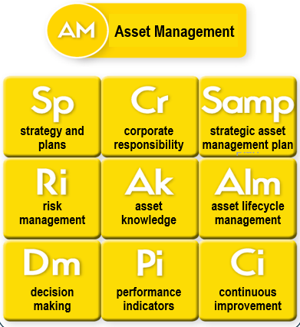
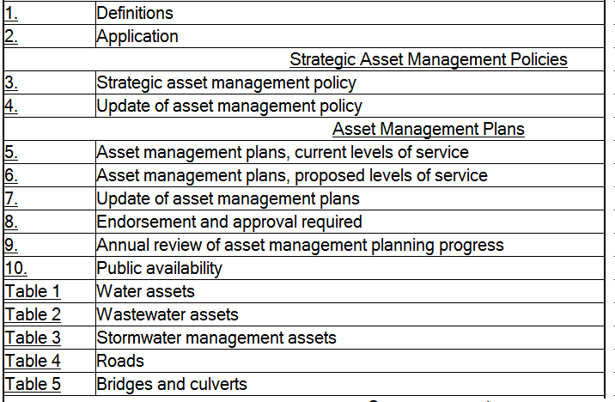
Strategic Asset Management Policies
ISO-55000
Asset Category; Asset Criteria/Definition
Replacement Cost; Asset Condition Tracking
Expected Service Life; Average Age
Levels of Service
Maintenance Schedules
Cost Tracking; Growth Plan; Capital Projects
Disaster Planning; Risk Management
Asset Management Plan by Category showing SLA
Reliability LeaderTM, Uptime® ElementsTM, Reliability Framework and Asset Management SystemTM and Reliability LeadershipTM are the trademark(s) or registered trademark(s) of NetexpressUSA Inc. d/b/a Reliabilityweb.com and its affiliates in the USA and in several other countries.

Slide 14
Maximo WBS
Design the CMMS to manage by exception
ASSET MANAGEMENT CONCEPTS
ASSET MGMT
KNOWLEDGE
1.0
SHAREHOLDERS
CMMS DATA
1.3
1.1
1.2
END-GAME
MISSION-VISION
CORPORATE
RESPONSIBILITY
FOUNDATION
DATA
INDUSTRY
BEST
PRACTICES
DECISION
MAKING
LONG RANGE
PLAN (LRP)
CONTINUOUS
IMPROVEMENT
CORPORATE POLICY
ASSET MANAGEMENT STRATEGY
TRANSACTION
DATA
ANALYTICAL
REPORTS
ASSET MANAGEMENT PLANS
RISK
MGMT
ACTION
TRACKING
Continuous Improvement
KPIs provide measures; analytics provide insight. Too often the CMMS user assumes the product o.o.b. will have the analytics they need.
This initiative is certainly valid but if left up to the day-to-day worker, minimal benefit may occur. Therein several techniques are warranted such as WO Feedback, asset condition capture, chronic failure analysis, RCA, defect elimination, auditing, SQL error checks, benchmarking, RACI chart, asset owners, story boards, posters, and of course training.
The analytical reports could very well impact the data capture requirements. Thus if the CMMS team fails to
think ahead, capabilities
will be lost.
The LRP is a greatly under-utilized tool for consolidating improvement initiatives and adding clarity.
MANAGEMENT
OF CHANGE
-- Steven Covey

Slide 15
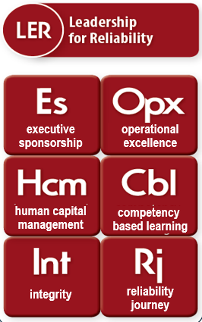
Create a Culture of
Reliability, Responsibility, and Accountability
Foundation for Reliability
Leadership for Reliability states that leadership comes from everyone.
Executive Sponsor should be the champion of asset management – at the executive level. He sets the AIM where reliability is an imperative. The executive sponsor communicates goals and helps initiates change, assigns accountability, and explains benefits. He also reviews expectations, addresses resistance, and reviews risks/roadblocks. Lastly, he explains why continuous improvement is critical. Top management is also responsible for creating and resourcing the Long Range Plan – containing improvement initiatives.
Reliability Leader - defined: Reliability Leaders promote excellence; develop innovative ideas in support of improve work force productivity and asset integrity’ plus, they nurture the development of others through demonstration and engagement. Reliability Team is coordination central for improvement ideas.
Anyone can be a reliability leader – including P&M Technicians. To be a reliability leader, you must be able to lead and exercise reliability leadership effectively with no title, no position, and no authority. A reliability leader strives to create a better future that might not otherwise exist.
Reliability Culture is created through leadership. And optimized performance is a principal result of this culture.
Reliability LeaderTM, Uptime® ElementsTM, Reliability Framework and Asset Management SystemTM and Reliability LeadershipTM are the trademark(s) or registered trademark(s) of NetexpressUSA Inc. d/b/a Reliabilityweb.com and its affiliates in the USA and in several other countries.
Notes:
This may actually be more difficult than it seems, as some organizations may not have the history or background that lends itself to the support of a reliability program. This can be particularly true in situations where the organization has had a niche market or little or no previous competition with the products they produce. In the past, their customers would have to accept the reliability of the product, good or bad. As a consequence, the organization may have developed a mentality that tends to overlook the reliability of a product in favor of the "damn-the-torpedoes, full-steam-ahead" method of product development. As a result, reliability engineering methods and practices tend to be viewed as superfluous or even wasteful. "We don't need all of this reliability stuff, we'll just find the problems and fix them," tends to be the attitude in these circumstances. Unfortunately, this attitude often results in poorly-tested, unreliable products being shipped to customers. The first step in developing the necessary culture of reliability is to have the support of the organization's top management. Without this, the implementation of a reliability program will be a difficult and frustrating process. Overall, a reliability program stands the greatest chance of success if everyone in the organization understands the benefits and supports the techniques involved.
Reliability is a term that has become more commonly used in the industry. Many organizations are using reliability to describe their predictive maintenance department. To me reliability has always encompassed the measurement of manufacturing efficiency and includes Operations, Maintenance, Engineering and Spare Part Stores as the major players.
To prevent maintenance work from occurring is the right thing to do. Whatever name you give your maintenance program it will always be important to execute the fundamental elements of maintenance better and better. To prevent maintenance or maintenance prevention includes the following must do essential elements.
Right equipment. Procurement of new equipment should be based on lowest Life Cycle Cost and include reliability and maintainability design.
Lubrication. It is still one of the most important things to do well by trained people.
Alignment must be done to a precision level with considerations to operating temperature, pipe strain, number of shims etc.
Filtration of hydraulic fluids, lubrication oils, seal water for mechanical seals must be done to specified levels.
Balancing must be done to precision level.
Operating Practices are essential to prevent maintenance. Operators must understand how to operate equipment and the impact wrong operating practices have. E.g. how to start a pump, what happens to an electric motor if it is dirty or is frequently started. Redundant equipment should be shifted to operate same amount of hours etc.

Slide 16
Maximo WBS
Someone at the executive level should be the primary sponsor of
asset management strategy
Understand shareholder values
Document goals & objectives
Promote reliability culture
Communicate vision
RELIABILITY BEGINS WITH LEADERSHIP
1.0
EXECUTIVE SPONSOR
1.1
1.2
SENIOR MANAGERS
STEERING TEAM
STRATEGIC
OPERATIONAL
PROJECT MANAGER
CMMS CORE TEAM
RELIABILITY TEAM
RELIABILITY CHAMPIONS
CMMS
ADMIN
BUSINESS
ANALYST
P&S
MGR
RELIABILITY
ENGR
HSE
MGR
MATLS
MGR
ASSET CARE SPECIALISTS
Goal: Create a
Culture of Reliability
OPS
MGR
MAINT
MGR
POWER USERS
1.4
1.3
HR MGR
DIFFERENCE MAKERS
Strategic alliance between
departments that supports shared goals
VISIONARIES
OPS SUPV
OPS
MGR
Team
Based
Approach
Tactical
TECHNICIANS
VP
TOTAL PRODUCTIVE MAINTENANCE
MAINT SUPV
MAINT
MGR
OPERATOR
DRIVEN
RELIABILITY
DEFECT
ELIMINATION
TEAMS
PLANT
SYSTEM
OWNERS
TRAINING MGR

Slide 17
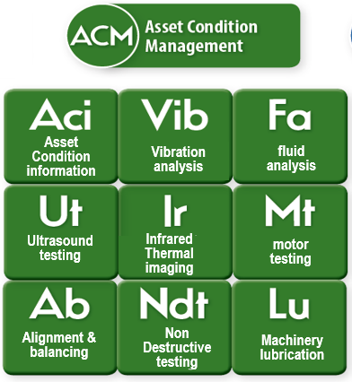
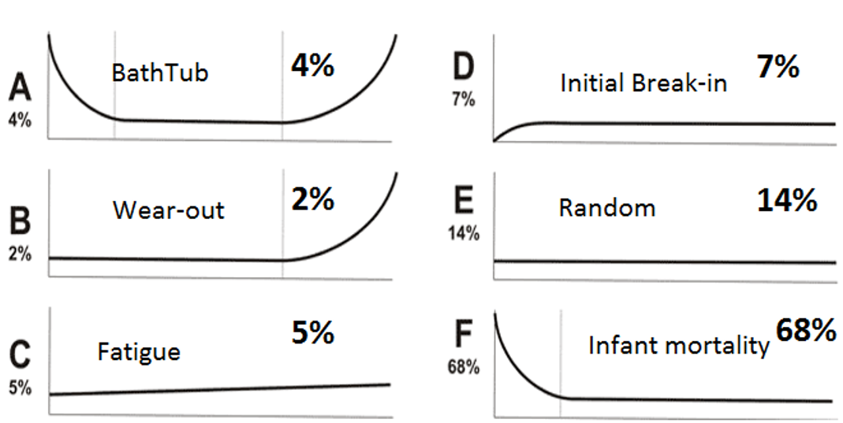
Only 11% of all failures are age related
Condition Based Technologies are scheduled activities, non-intrusive, and provide early warning.
If that is true, why are we doing so many overhauls, replacements and servicing?
Age Related Random
Reliability LeaderTM, Uptime® ElementsTM, Reliability Framework and Asset Management SystemTM and Reliability LeadershipTM are the trademark(s) or registered trademark(s) of NetexpressUSA Inc. d/b/a Reliabilityweb.com and its affiliates in the USA and in several other countries.
Notes:
Fixed Time Maintenance is very seldom justified and often leads to over maintaining. Only if it is justified based on failure developing times and distribution of failures in time it can be cost effective to do.

Slide 18
Maximo WBS
Goals:
Asset Preservation
Managed Risks
Less Downtime
Return on Capital
RCM Decision Tree selects tactic
Strategy must be viable
Certified staff for CBT
Precision skills
Asset Condition Management
1.0
Delivery Model
The life of an asset is documented by transactional data, CBT, SCADA and staff observations.
MEET STAKEHOLDER EXPECTATIONS
1.1
1.2
PF Curve Position
ASSET
TYPE
AND
FUNCTION
Opinions from tribal knowledge
O&M Technician sensory & log readings
Graded asset condition
CMMS failure history
Data historian; SCADA
Vibration analysis
Infrared thermography
Ultrasound
Fluid analysis
Motor testing
Non Destructive Testing (NDT)
Low
Low
Mid
Mid
Mid
High
High
High
High
High
High
1.3
SUSTAINED EXCELLENCE
Decisions to be made
Replace asset
Design change
Repair asset
Continue operating but alter frequency
Install on-line monitoring
No action; no defect
1.5
COST AVOIDANCE RPT
1.4
Repaired
before failure
Training and certification should be supported as incentives for technicians to increase skillset, provide more effective maintenance, and be better compensated.
// Jack Nicholas, Jr., Uptime, Jun-Jul 2017
CONDITION BASED TECHNOLOGIES (CBT)
and PREVENTIVE MAINTENANCE
Preservation Techniques
Machinery lubrication
Alignment & balancing
PM restoration
Visual testing/inspection
Cleaning
WORK SCHEDULE
ASSIGNED CRAFT
RISK BASED PRIORITIZATION MATRIX
PRECISION MAINTENANCE SKILLS
ASSET RECORD DATABASE
CRITICALITY
ASSET CONDITION
MANUFACTURER/MODEL
PURCHASE HISTORY
WARRANTY; AGE
REPLACEMENT COST
FUNCT. CHARACTERISTICS
WORK BACKLOG
ROUTINE & URGENT WORK
Notes:
Pareto analysis is the best tool for determining where to start a RCM process.
A good RCM implementation will result in maintenance actions, operator actions, training changes, procedural or process changes, engineering changes and conscious decisions to run some assets to failure.
1.1 Criticality Analysis – Determine critical systems. And within those systems, determine critical assets.
1.2 RCM Analysis -

Slide 19
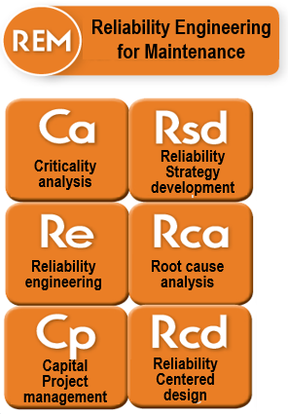
How can you guarantee Reliability?
You can’t
But we can improve the odds
Reliability LeaderTM, Uptime® ElementsTM, Reliability Framework and Asset Management SystemTM and Reliability LeadershipTM are the trademark(s) or registered trademark(s) of NetexpressUSA Inc. d/b/a Reliabilityweb.com and its affiliates in the USA and in several other countries.

Slide 20
Maximo WBS
Goal: The organization must
continually improve processes, reduce costs,
and cut waste to
remain competitive.
Perform investment planning
Ensure reliability in design
Manage capital projects
Operate & maintain
STRATEGIES for RELIABILITY
1.0
IDENTIFY & MANAGE RISKS
It’s not possible to design out all possible defects therefore the organization must deploy methods to detect failure, find true cause and mitigate it’s effects.
RCA
Trigger
Points
CBT = Condition Based Technologies
NORMAL PLANT OPERATION
O&M TECHNICIAN
PERFORM PRECISION MAINTENANCE
SIGNIFICANT
EVENT
1.6
1.1
Root
Cause
Analysis
CMMS PM/CBT
LIBRARY
10-15%
1.5
CRITICALITY
ANALYSIS
RCM
ANALYSIS
1.2
Time-Usage based Work Orders
70-75%
Monthly Meeting
PMO
ANALYSIS
1.3
RECURRING
FAILURE
1.7
LIVING
PROGRAM
10-15%
Chronic
Failure
Analysis
OEM
RECOMMENDATIONS
1.4
CBT
Discovery
ROUTINE + URGENT REPAIR WORK
WO COMPLETION UPDATES
Store RCM Analysis results inside CMMS
1.8
One-off WO failure mode comparison
WO
Feedback
Pareto sort identifies worst offenders and drills down on failure mode to find true cause
Notes:
Pareto analysis is the best tool for determining where to start a RCM process.
A good RCM implementation will result in maintenance actions, operator actions, training changes, procedural or process changes, engineering changes and conscious decisions to run some assets to failure.
1.1 Criticality Analysis – Determine critical systems. And within those systems, determine critical assets.
1.2 RCM Analysis -

Slide 21
Upper Mgmt Conduct Review LRP
Present LRP to Stakeholders
Conduct User Surveys
CRL Accreditation
Road
Map
Setup/Configure Fields:
5 Annual Maint Costs to Asset
Functional Failure on WO
Out-of-Service on WO
TypeWork field (with pic list)
WO Feedback
Activate CMMS Functionality:
Type-Ahead
Prefix WO with “YY-”
Capture Actions Performed
Setup Capital Tool Tracking
Meter-based PMs
Perform RCM Analysis
Cost Avoidance Report
Store RCM Analysis inside CMMS
Perform PMO Analysis
Create Power Applications:
Defect Tracking
RCM Analysis Screen
WO Ranking Matrix
HSE Accident/Incident Tracking
PM Basic & Commitment Repository
Perform Criticality Analysis
Gather OEM Recommendations
Enhance Asset Reliability
Understanding the end-game gives an organization significant competitive advantage.
Bus. Rule:
CM Worktype for Repair
Perform
Defect Elimination
Design-Build Failure Analytic
Setup Reliability Team
Chronic
Failure
Analysis
Failed Component
Component Problem
Cause Code
Capture Failure Mode
Capture Accurate Failure Data
Optimize O&M Costs with ROA
Setup
Root Cause Analysis
Asset Install Date, Warranty Expiry, Replacement Cost
Allow Pareto Sort on Report:
# Work Orders
Operational Downtime
Asset Condition
Avg Annual Maint Cost / ERV
Asset Age
Organizations that deploy
the best reliability-based maintenance practices provide the best availability at lower cost.
Setup Asset Cond. Capture
Improve Workforce Productivity
Perform Precision Maint. Training
Autoscript for Oper. Downtime
Autoscript for Avg Ann Maint $$
Design-Build Pass-Down Report
Improve CMMS SOPs
Provide Ease-of-Use for Core System use
Build Charter
Build RACI
Formalize WORM team
Create Business Rules
Build CMMS Definitions
Create Error Checks
Define Business Analyst
Maintain Punchlist
Solidify Vision/Mission
Create Posters
Setup Book Club
Incident Reporting
Promote
Job Safety
Create Backlog Growth Report
AutoScript
for Rough Estimate
Formalize Core
Team
Imp. Backlog Management
Improve Job Planning
AutoScript
for Backlog Ranking
Punchout
Setup SR Web Based
Evaluate
Speed/
Perfor-
mance
Make Oracle WO required
Spare Part Integration
Integrate MX PR to Oracle
TRM John Reeve
Rev 1, 11/02/2017

Slide 22
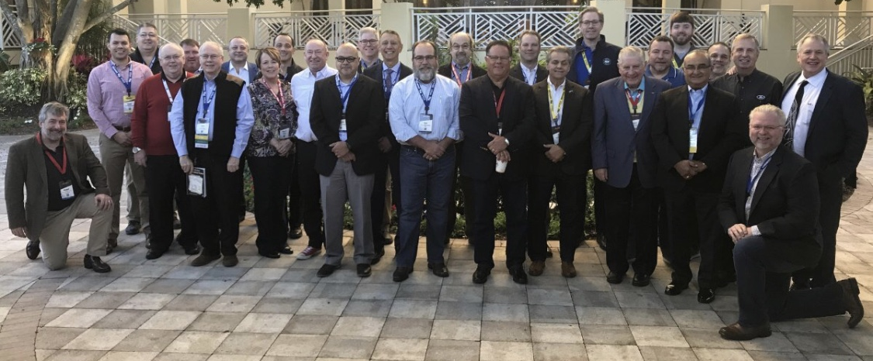
Authors Breakfast – IMC 2017
maximo
Benchmarking: An Essential Strategy
for every CMMS Core Team
Failure Modes to Failure Codes
*** Short Course ***
world
Aug. 2018
John Reeve
John Reeve
John Reeve
John.Reeve@TRMNET.COM
Notes:
10 ways to perform benchmarking:
Asking others in the organization for their opinions on methods to improve.
Conducting end-user surveys to stay in touch with working level.
Conducting process audits to verify adherence.
Staying in touch with latest technology.
Visiting other sites/organizations to find industry best practices.
Researching topics on internet; reading books on the subject.
Attending user forums – including non software centric; listening-learning.
Bringing in a local vendor who specializes in condition monitoring technologies.
Bringing in a speaker for the day.
Bringing in consultant to conduct week long site assessment.

