Slide 1
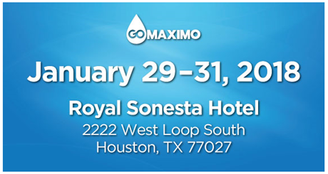
Asset Management Fundamentals
A foundation for Advanced Asset Management
Jan. 29th Monday
3:30pm – 4:15pm
Champions Vi
Scott.Stukel@trmnet.com
John.Reeve@trmnet.com

Slide 2
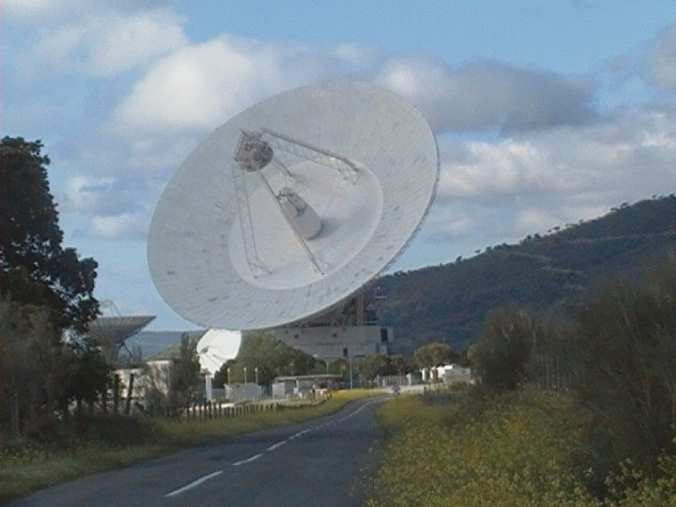
Scott Stukel, CMRP
BSME, EE/CE Minors – Kettering University (formerly GMI)
28 Years of experience in Engineering, Maintenance and Asset Management Practices & Technology
16 Years of Asset Management & EAM Consulting Experience
Seasoned Asset Management, ISO-55000, IIMM Practitioner and Advisor
Former NASA Deep Space Sr. Engineer & RCM Lead
Guinness World Record Holder, Engineered Worlds Largest Rice Krispies Treat for Charity/Reality TV Program

Slide 3
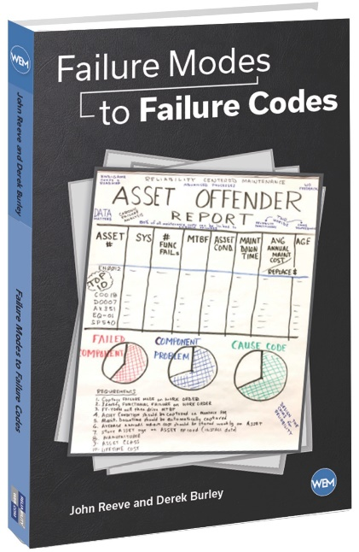
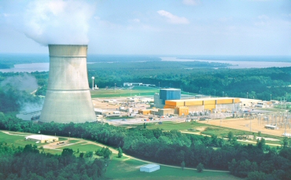
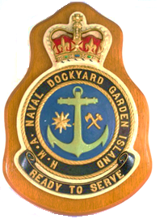
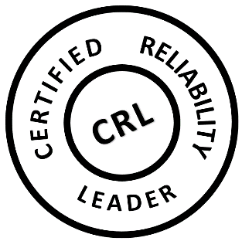
John Reeve, CRL
Grand Gulf
Nuclear Station
U.S Patent 7,421,372 Maintenance
Scheduling
2nd consultant hired by the company that invented Maximo.
Spent the first 10 years as an international consultant in project management supporting cost/schedule design. Aerospace and defense industries, as well as nuclear power, depended on this software.
U.S. Patent in maintenance scheduling – called the “order of fire” for resource leveling
In the following 20 years, specialized in asset management design.
Certified Reliability Leader
13,000 LinkedIn followers
100 postings on industry best practices, numerous trade magazine articles
Frequent speaker at Reliability Web and Maximo software venues
Book: Failure Modes to Failure Codes
Able to comfortably discuss advanced processes for both asset reliability and work force productivity.
Significant overseas assignments include Australian Defence Industry (Sydney), Australian Submarine Corporation (Adelaide), Pohang Steel (South Korea), Guangdong Nuclear Power (China) and Power Generation Company of Trinidad.
Aided in 1st RCM for Maximo Industry Best Practices course, taught as PSDI consultant
100
Posts

Slide 4
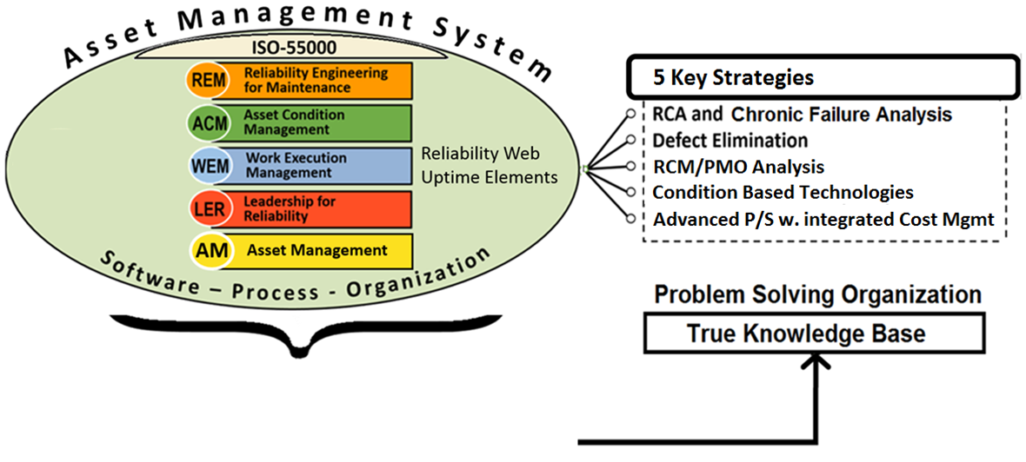
Asset Management is what you extract
from the Asset Management System
Advanced processes provide the largest potential
return on investment
MAXIMO
CMMS
The software may be world class but you still need someone to state the vision, and then, develop supporting processes.

Slide 5
What is the purpose of Asset Management?
To optimize asset reliability / availability
To improve work force productivity and job safety
To manage by exception; to make more informed decisions
Why?
To optimize O&M costs
To stay competitive
To make a profit
To contribute to society
How?

Slide 6
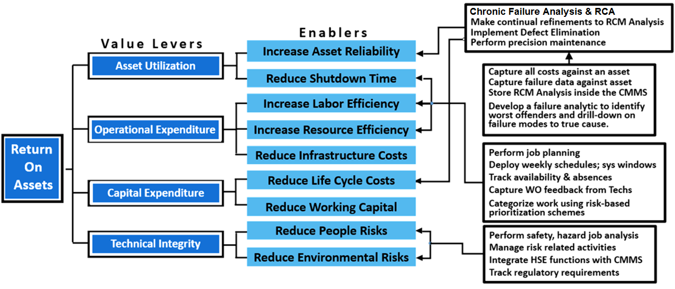
How do you optimize Costs to Improve Reliability?
Answer:
Track ROA
Reliable companies will have a competitive advantage due to best-in-class practices. This allows them to maintain a positive margin even in a depressed market place.
Maximo Advanced Processes
Notes:
Reliable companies have a competitive advantage due to best-in-class practices. This allows them to maintain a positive margin even in depressed market place. Lastly, a single, cohesive strategy that involves people, culture and excellence provides the best path for success.

Slide 7
Express Value in terms of ROI
Risk and Compliance Management
• Regulatory compliance
• Health Safety & Environment
Business Scenarios | ROI Points
Labor Utilization | Up 10-20%
Asset Utilization | Up 3-5%
Equipment purchases | Down 3-5%
Warranty recoveries | Up 10-50%
Plant Downtime | Down 5-20%
Inventory needs | Down 20-30%
Inventory carrying costs | Down 5-20%
Material Costs | Reduced 10-50%
Purchasing labor | Reduced 10-50%
Operational Excellence
• Best Practices
• Reliability
Business Agility
• Process Standardization
• Ability to Adapt
ROI & Value
Business Alignment
• Investment Accuracy
• Supporting Strategic Goals
System Consolidation
• One version of the truth
• Cost and Complexity
*Thanks IBM

Slide 8
From an Asset Management perspective what have you been successful at? What have you not been successful at?
Group Discussion

Slide 9
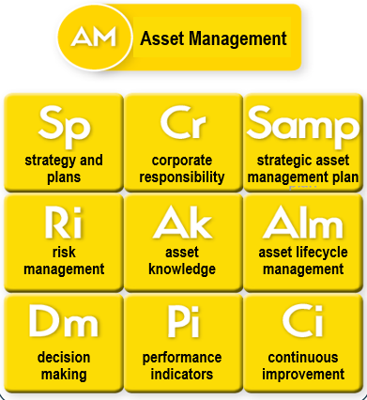
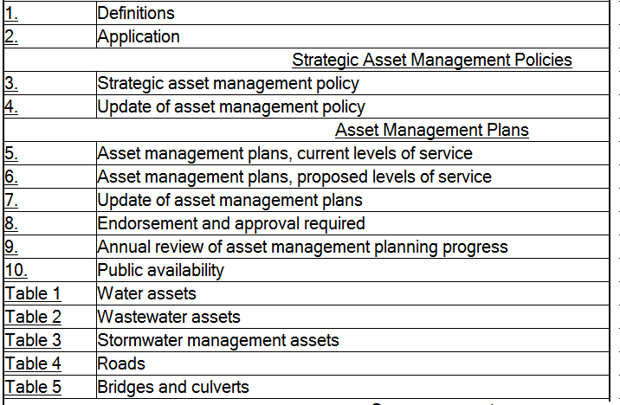
Strategic Asset Management Policies
ISO-55000
Asset Category; Asset Criteria/Definition
Replacement Cost; Asset Condition Tracking
Expected Service Life; Average Age
Levels of Service
Maintenance Schedules
Cost Tracking; Growth Plan; Capital Projects
Disaster Planning; Risk Management
Asset Management Plan by Category showing SLA
Reliability LeaderTM, Uptime® ElementsTM, Reliability Framework and Asset Management SystemTM and Reliability LeadershipTM are the trademark(s) or registered trademark(s) of NetexpressUSA Inc. d/b/a Reliabilityweb.com and its affiliates in the USA and in several other countries.

Slide 10
The Strategic Asset Management Plan (SAMP)
The SAMP contains documented information about the organization’s Asset Management strategy that specifies the following:
How organizational business objectives are to be converted into asset management objectives,
The approach for developing asset plans & sustaining models, and
The role of the asset management/EAM (Maximo) system in supporting achievement of the asset management objectives

Slide 11
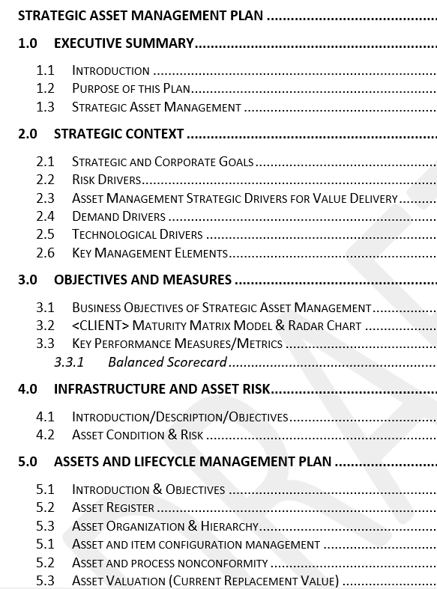
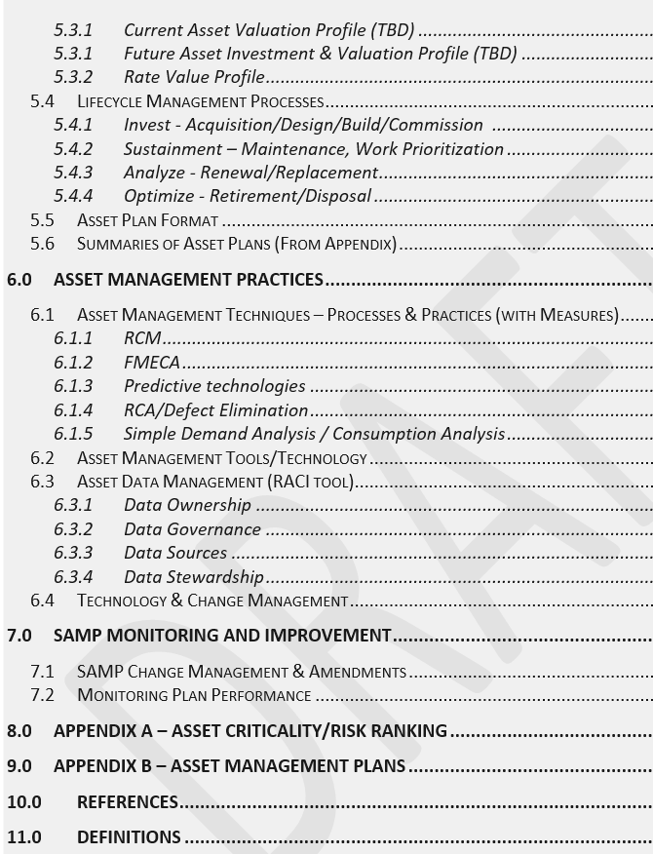

Slide 12
ISO-55000 Elements
8.2 Management of Change
9.1 Monitoring, measurement, analysis, & evaluation
9.2 Internal Audit
10 Improvement
4.1 Organization and context
4.2 Stakeholder needs
5.1 Leadership & Commitment
5.3 Org. Roles, Resp, & Authority
5.2 Asset Management Policy
4.3 AM System Scope
6.2.1 AM Objectives
6.2.2 Planning
8.3 Outsourcing (scope)
4.4 Asset Management System
6.1 Actions to address risks
8.1 Operational planning & control
8.2 Management of Change
8.3 Outsourcing (control)
7.1 Resources
7.2 Competence
7.3 Awareness
7.4 Communications
7.5 Informational Requirements
7.6 Documented Information

Slide 13
Asset Management Benefits
Happier shareholders
Improved financial performance
Informed asset investment decisions
Improved risk management
Improved services and outputs
Demonstrated social responsibility
Demonstrated compliance
Enhanced reputation
Improved organizational sustainability
Improved efficiency and effectiveness

Slide 14
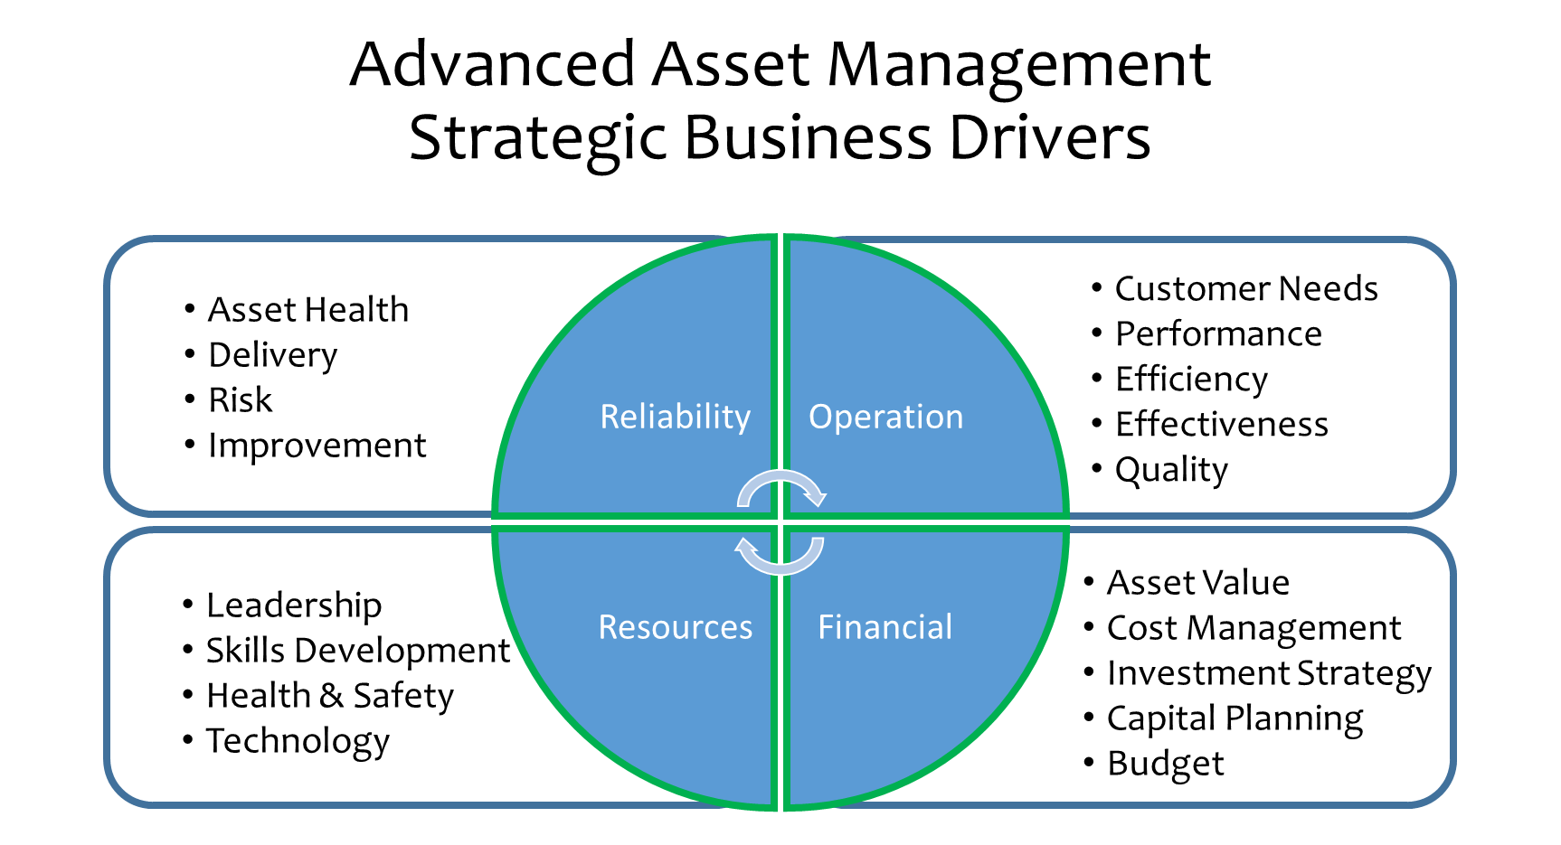
Total Resource Management, © 2017

Slide 15
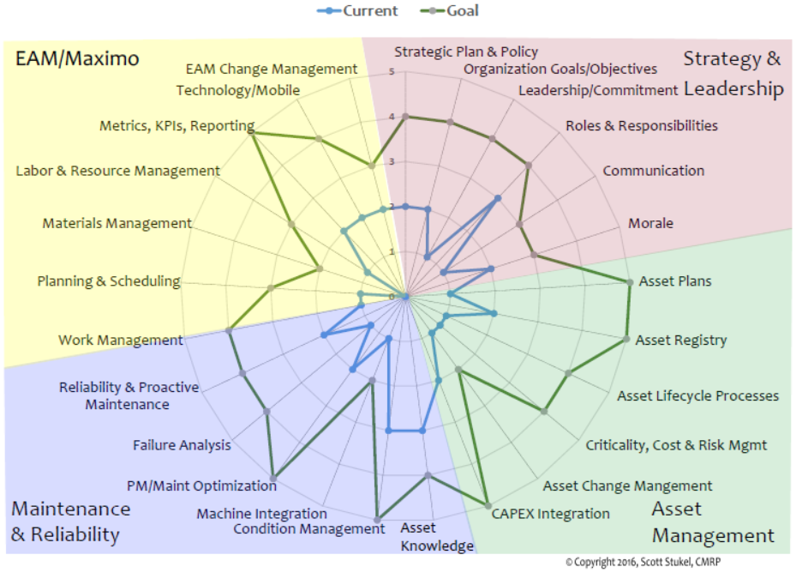
Asset Management – Self Assessment
Spider
or
Radar
Chart
This helps us determine where to focus

Slide 16
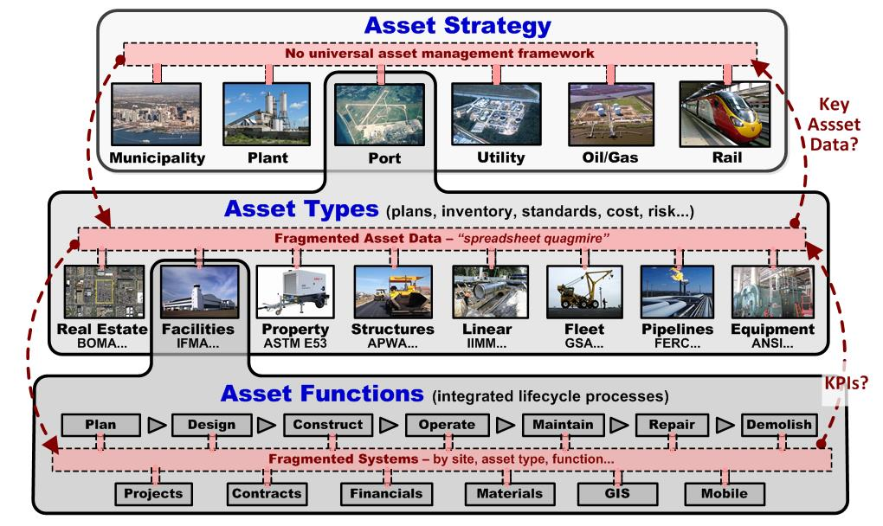
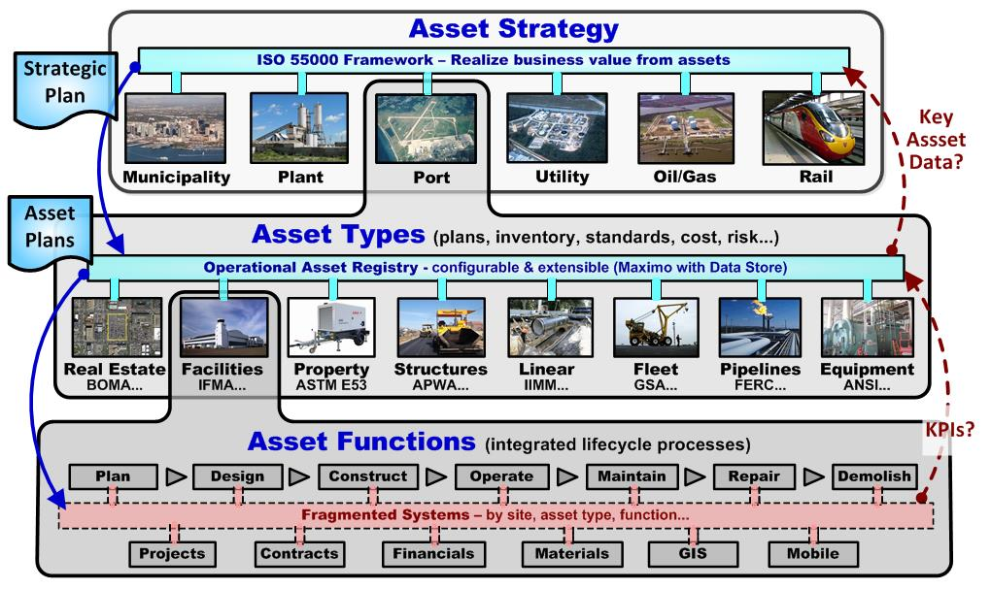
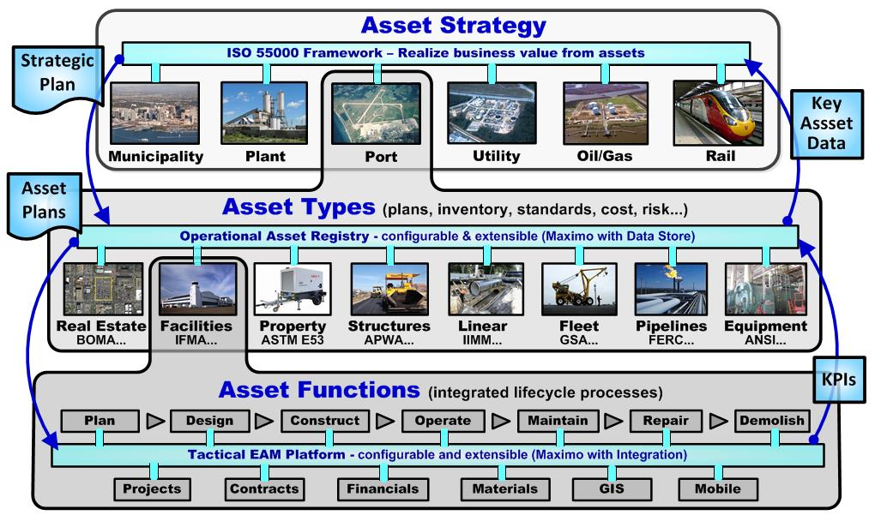
Align “their” Strategy with your Assets Your Challenge: Understand and support the needs of Boardroom, Business Line, & Floor/Field

Slide 17
The Asset Plan
Documented information that specifies the activities,
resources and timescales required for an individual asset, or a grouping of assets, to achieve the organization’s asset management objectives.
(1) The grouping of assets may be by asset type, asset class, asset system or asset portfolio.
(2) An asset management plan is derived from the strategic asset management plan.
(3) An asset management plan may be contained in, or may be a subsidiary plan of, the strategic asset management plan.

Slide 18
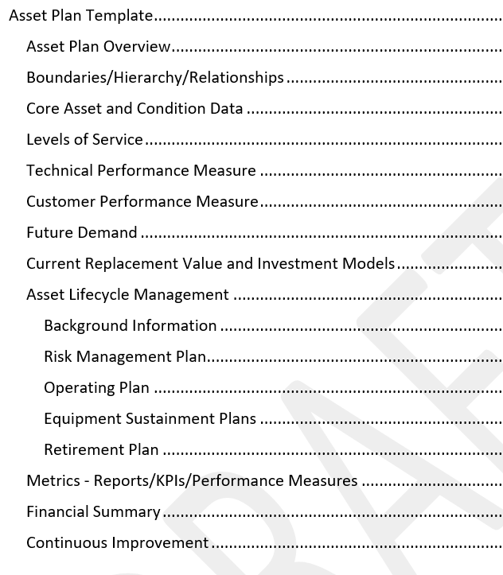

Slide 19
Align Strategy with Assets & Work Midstream example – Gas Transmission Pipeline Management
Business Strategy – 95% availability for assets to prevent expanding treatment infrastructure
Asset Plan – Must integrate operating, lifecycle/sustaining, and investment/financial factors. Including measures.
CMMS – Need to implement & utilize multiple modules.

Slide 20
Best Practice Tiers
Tier 1 – Asset Identification & Organization
Asset Registry
Asset Info
Asset Classes
Organization/ Hierarchy
Tier 2 – Work Control
Work Orders
Labor Hours
Failure Rep.
Costs
Tier 3 – Workforce Utilization
Labor Availability
Planning
Scheduling
Backlog
Tier 4 – Reliability & Asset Health
Tier 5 – Proactive Asset Management
Asset Health
CBM
Asset Intelligence
Analytics
Proactive Support of Business Objectives
Investment/Capital Planning
Cost Management
Predictive Budgeting & Forecasting
Resource Optimization
Strategy/Plan
Implement/Execute
Measure
Improve
© Total Resource Management, 2017

Slide 21
Implementing Asset Plans in Maximo
Asset Management/Plan Element | Maximo Function
Asset Organization, Asset Registry | Assets, Locations, Location Systems
System, Subsystem, Assembly, Asset Risk Ranking & Prioritization | Assets, Locations, Systems (coded with severity and likelihood factors)
Baseline Maintenance Approach (Preventive, Predictive, RTF) | Preventive Maintenance, PM Masters, Job Plans, Condition Monitoring, Work Orders
Functional Failure Analysis, FMEA/FMECA | Failure Hierarchy, Failure Reporting
RCM Task Evaluation, RCM Task Selection | Job Plans, Job Plan Tasks
Asset Condition & Performance | Condition Monitoring, Measurement Points, Meters
Standardized Maintenance Work Instructions | Job Plans
Work Authorization & Execution | Work Orders
Maintenance Reporting, Analysis, KPIs, Continuous Improvement | Work Orders, Asset History, Downtime Reporting, KPIs, Start Center, Work Centers/Dashboard

Slide 22
Responsibilities from Board Room to the Ground
Executives –Business Drivers, Strategy, Budget, Resources
Directors/Managers– Roadmap, Policy, Standards, Measures, Plan, Processes, Direction, Business Performance
Reliability Engineers – Asset Performance, Analysis, Improvement
Planners/Schedulers – Estimating, Work Planning, Work Scheduling
Supervisors – Work Assignment, Resource Management, Communication
Technicians – Work Execution, Feedback

Slide 23
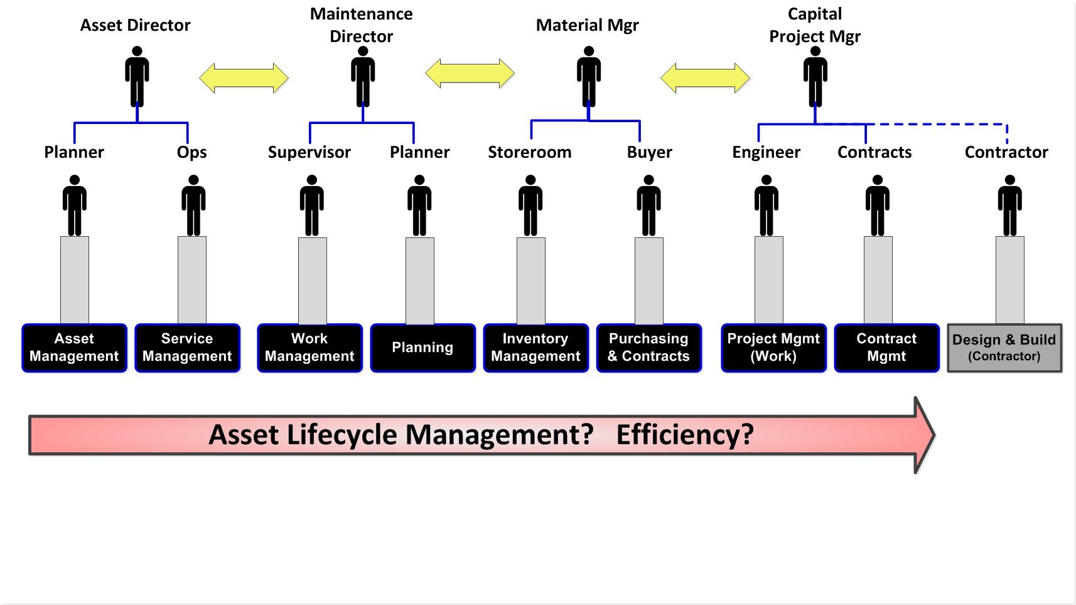
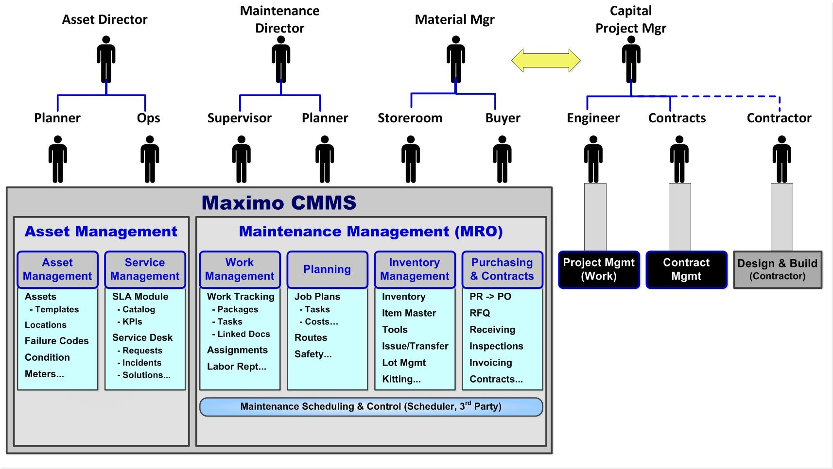
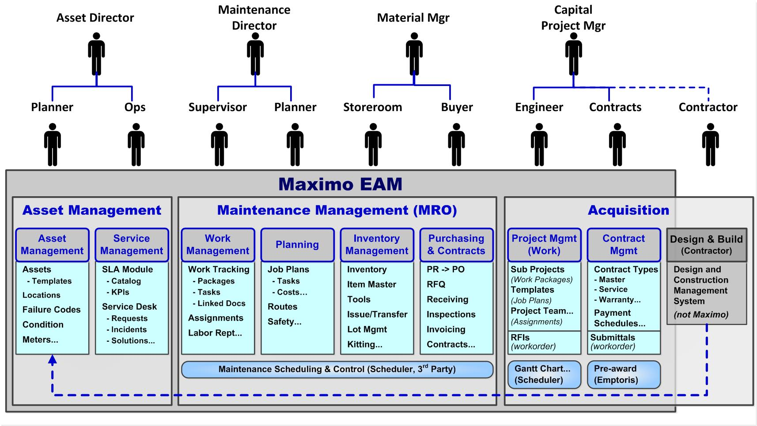
Roles, Responsibilities and Who Does What
Beware of Silos
“… while [infrastructure entities] have made significant investments in the last 20 years, they are stand-alone systems with limited capability for sharing information… isolated silos.” – ASCE 2007
Notes:
A key strategy is to sell your leadership on Maximo as the Lifecycle EAM solution that can integrate functional silos… At the CXO level, many are not aware of this capability and may have bought into the CFO’s pitch that “we can do all with a financial-centric ERP”. As shown in the bottom quote, this functional stovepipe challenge has been well known in the infrastructure domain. This fragmentation makes lifecycle management nearly impossible – and creates major process inefficiencies.
The progression to an EAM generally follows these two steps:
CLICK
The old CMMS term reflects the integration of maintenance stovepipes as shown here – as you can see in the blue boxes, Maximo was built to supports these functions.
The next step is to incorporate the acquisition functions – projects, contracts and construction.
CLICK
Many companies use Maximo for both Project and Contract Management. As a flexible solution, Maximo can be configured to support both. And IBM improved these capabilities – Maximo Scheduler can provide Gantt chart capability for a project with multiple work phases. And, the recent Empotoris acquisition provides improved contract capability. The actual construction work is typically managed by contractors in 3rd party systems like Primavera – however, getting the asbuilt information back to Maximo is important. Some companies perform this transfer by specifying data requirements from the contractor and pushing to Maximo with scripts. While some companies are utilizing Building Information Modeling or BIM to provide this integration.
Bottom line: Maximo has the capability to support the asset lifecycle and be an integrating platform.
CLICK

Slide 24
Assessment -- with Deliverables
Assessment | Deliverable
1. Strategy/Objectives Definition/Workshop | Radar Chart/Prioritized Objectives
2. Adoption of Best Practices to the Business | Roadmap
3. Blueprint to implement Roadmap | Action Plan
4. Best Practice Maximo/EAM Implementation | Technology Enablement Plan & Design
5. Best Practice Instance Configuration | Configured Solution
6. Training | Executed Training/Knowledge Transfer
7. AAM Best Practice Maximo | User Access
8. Monthly Best Practice Workshops - Tiers | Educational Webinars & Open Forum
9. Quarterly Health Check | Scorecard, findings, recommendations

Slide 25
Accelerated Path to Effective AAM in Maximo
Advanced Asset Management
Turn-key Maximo solution with best practice processes and pre-configured applications, value lists, failure codes, asset classifications, reports and KPI’s for areas like:
Work Optimization Analytics
Advanced Failure Analytics
Asset Health
Planning & Scheduling
Labor & Material Management, Budgeting, Forecasting
Reliability Centered Maintenance Support

Slide 26
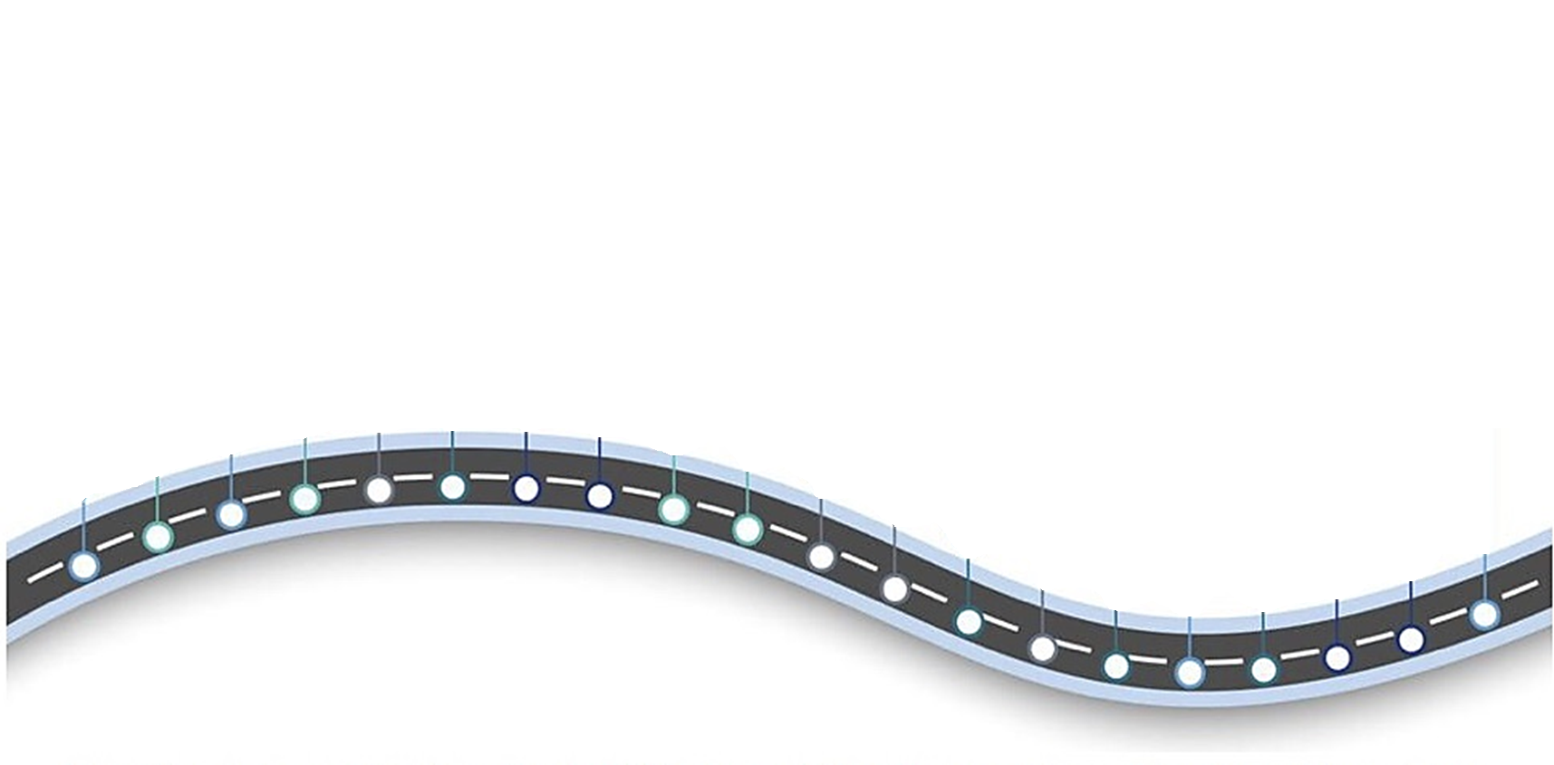
Asset Management Roadmap
Although each journey is unique, the Asset Management Roadmap creates a comprehensive long range plan based on organizational priorities and availabilities.
The Long Range Plan also supports sustainment activities, such as:
Benchmarking activities
Attending Maximo World
Obtaining CRL staff accreditation
Error Checks and Proactive Audits
Assumption:
CMMS is installed.
Organization requests assistance in Asset Management processes
Requests Long Range Plan showing improvement initiatives
Goal: Design the CMMS with intent to extract value-add information
Capture Failure Mode on WO
Establish
Core
Team
Define
Critical
Procedures
Perform
GAP
Analysis
Create
Strategic
Plan
Configure
System
04
Identify
Best
Practices
06
Create
AS-IS
TO-BE
08
Define
Failure
Analytic
Create
Action
Plan
02
Identify
Stakeholders
10
Create
Long Range
Plan
07
Create
Reliability
Team
Implement
Chronic
Failure
Analysis
05
Perform
Criticality
Analysis
Optimize
Planning
Scheduling
Define
End-Game
03
09
12
Fix
Missing
Foundation
Data
20
01
11
14
Impl.
Mobile
Solution
Conduct
Blended
Training
16
18
Perform
RCM/PMO
Analysis
13
19
15
17
You can install software,
but you cannot install reliability.
Scott.Stukel@trmnet.com
John.Reeve@trmnet.com
Notes:
Document Requirements
Create Process Flows
Gap Analysis
Create Action Plan
Core Team (Charter) & End Game
Business Rules & Definitions
Establish Error Checks
Document Critical Procedures
Create “Power User” training program
Identify Maintenance Analyst
Create Reliability Team
Define Failure Analytic
Implement Mobile Solution
Perform Benchmarking
Conduct Blended Training
Attend Maximo World
Obtain CRL Certifications
Hire Planner/Scheduler
Perform Criticality Analysis
Perform RCM/PMO Analysis

